Slide 1
Nerdschool
JavaScript Infrastructure and Tooling

Slide 2
Automate your tasks!
IDE / editor will help with code completion and formatting
We still have many manual tasks:
Managing dependencies
Copying references to output directory
Manage order of imported documents
Compile code files
Verify code
Host the website

Slide 3
Package managers
Package managers are tools that help us distribute, install, uninstall and update software pieces
Other applications
Plugins
Libraries
Configurations
Every plattform have package managers!
OS package manager
IDE package manager
Technology package manager, etc

Slide 4
Package managers on the Node plattform
NPM – Node Packaged Module
Written in JavaScript
Provides packages for JavaScript development
Other package managers
Command line tools
Modules
Libraries
Bower
Runs on Node plattform and requires npm
Downloads file from git repositories
Packages for front-end development
Libraries

Slide 5
Task runners for JavaScript
Tools that automate our repetitive work in JavaScript applications
Grunt
Focus on configuration
Tasks are independent and sequential
Files opened and closed independently
Large community, endless options
Easy learning curve
Gulp
Focus on code
Tasks oftenly runs in a pipe, and different pipes runs in parallell
Files are put into streams and does not need to be stored on disk
Large community, diversity not yet on Grunt level
Steep learning curve

Slide 6
Gruntconfig, the structure
JavaScript configuration object
Contains a property for each configured task which again is a configuration object for that specific task
Tasks may have different configurations for different settings
An example build up:

Slide 7
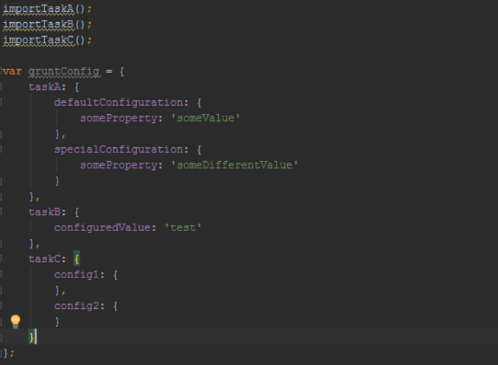
Example grunt config

Slide 8
SASS – Syntactically Awesome StyleSheets
Compiles to CSS
Write CSS in something which looks like a programming language
Functions, variables, nested structures

Slide 9
Examples in Open Source
https://github.com/jasmine/jasmine
https://github.com/lorenzofox3/Smart-Table

Slide 10
Developer tools

